Slide 1
NATURAL NUMBERS
AND
WHOLE NUMBERS
STD-VI
Prepared by:
Mr. Harihar Satapathy
DAV INSTITUTIONS ODISHA ZONE -1
DAV PUBLIC SCHOOL, KALINGA NAGAR, BBSR

Slide 2
Learning Objectives
Students will be able to:
Recall the concept of natural numbers
Know the concept of whole numbers
Find predecessor and successor of any whole number
Represent the whole numbers on the number line
Add, subtract, multiply and divide the whole numbers
Understand and verify the properties of whole numbers:
Closure property.
Commutativity of addition and multiplication.
Associativity of addition and multiplication.
Distributivity of multiplication over addition and subtraction.
Identities for addition and multiplication.
Estimate the sum, difference and product of whole numbers.
Simplify the problems using BODMAS rule.

Slide 3
NATURAL NUMBERS

Slide 4
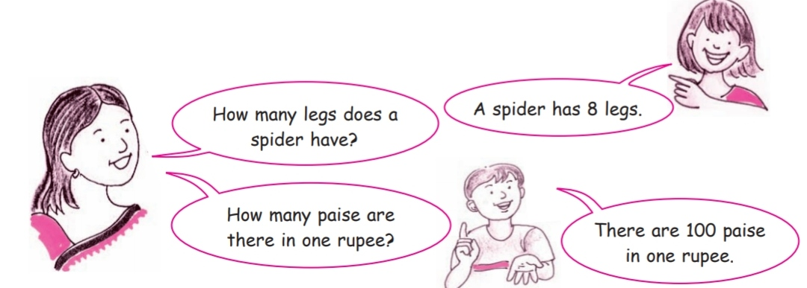
INTRODUCTION
Why we start counting with 1 not 0?
What these numbers known as?

Slide 5
What are Natural numbers?
All counting numbers are called Natural numbers.
OR
The numbers starting from 1 are called Natural numbers.
Example-
1, 2,3 ,4, 5 … are called Natural Numbers.
Note:-
“1” is the smallest Natural number.
There are infinite number of Natural Numbers.
There is no greatest Natural number.

Slide 6
WHOLE NUMBERS

Slide 7
Look at the following picture.
What is the number of boys in this group?
The number of boys in the above group is zero(0)

Slide 8
Whole Numbers
Natural numbers along with 0 form a system of whole numbers.
Example-
0, 1, 2, 3, 4 … are whole numbers.
Note:-
“0” is the smallest Whole number.
There are infinite number of Whole Numbers.
There is no greatest Whole number.

Slide 9
Let’s Think
Is every natural number a whole number?
Is there any greatest whole number?
Is there any smallest whole number?
Is there any smallest natural number?

Slide 10
Representation of whole numbers on number line
Represent the following on the number line
7 (ii) 9 (iii) 12
Point “A” represents 7
Point “B” represents 9
Point “C” represents 12

Slide 11
SUCCESSOR AND PREDECESSOR
One (1) more than any whole number is called successor of the whole number
One (1) less than any whole number is called predecessor of the whole number
9999 + 1 = 10000 (successor of 9999)
1000 – 1 = 999 (Predecessor of 1000)
Similarly, Successor of 5689 = 5689 + 1 = 5690
Predecessor of 5689 = 5689 – 1 = 5688

Slide 12
OPERATION ON WHOLE NUMBERS
Addition of whole numbers (Activity)

Slide 13
Property 1 (closure property):
The sum of two whole number is again a whole number.
Example –
3+9=12 (Whole number)
Property 2 (Commutative Property)
The sum remains the same even after changing the order of the addends.
Example:-
7+8 = 8+7 = 15

Slide 14
Let’s Watch This

Slide 15
Property 3 (associative property)
The sum remains the same when order of the grouping three addends is changed.
Example-
15+(12 +7) =(15+ 12)+7 = 34
Example-
Add (578+450+422+250) by suitable rearrangement
Ans-
(578+422)+(450+250)
=1000+700
=1700

Slide 16
Property 4 (Identity property)
When a number is added to zero then the sum is the number itself.
Example-
17 + 0 = 0 + 17 = 17
So, Zero(0) is called the additive identity of addition.

Slide 17
SUBTRACTION OF WHOLE NUMBERS
Property 1 :- The difference between two whole numbers may or may not be a whole number.
Example- 7-5 =2
But 5-7 = -2
Here closure property is not satisfying for whole numbers.
Hence, whole numbers are not closed under subtraction.

Slide 18
Property 2 – The difference between two same whole number is always zero.
Example 9 - 9 = 0
Property 3 – For any three numbers x, y & z then
(x-y)- z ≠ x-(y-z)
Here associative property is not satisfying.

Slide 19
Property-4 : When 0 is subtracted from a whole number, the difference is the number itself, i.e. q-0 = q Property-5 : If a, b, c are three whole numbers then a-b=c => a=b+c (verification) Example- Add by rearranging them 2062+847+938+353 =(2062+938)+(547+353) =3000+900 3900

Slide 20
Multiplication of whole numbers
Property 1 : closure property- If two whole numbers are multiplied then the result is also a whole number.
Example- 3 X 5 = 15 (Whole number)
Property 2 :Commutative property – If two numbers are multiplied in either order the product remains the same.
Example-
7 x 5 =35
5 x 7 = 35
Property 3 : Associative property – If three numbers are multiplied in any grouping or order the product remains the same.
Example – 7 x (9x5) =(7x9) x 5

Slide 21
Property 4 : Identity property – The product of a whole number and 1 is the number itself.
i.e, 1 x 7 = 7 x 1 = 7
Property 5 : The product of any whole number and zero is zero.
i.e, 725 x 0 = 0 x 725 = 0

Slide 22
Distributive Property :
If a, b, c are three whole numbers then
(i) ax(b+c) = ax b +a x c (over addition)
(ii) ax(b-c) = ax b - a x c (over subtraction)
Is known as distributive property of multiplication over addition.
Is known as distributive property of multiplication over subtraction.

Slide 23
Example 1-
Multiply 279 x 99 by using distributive property.
Ans-
279 x 99
=279 x (100-1)
=279x100 – 279x1
=27900 -279
=27621
Example 2-
Multiply 1002 x 790 using distributive property.
Ans-
1002 x 790
=(1000+2) x 790
=1000x 790 + 2 x 790
=790000 + 1580
= 791580

Slide 24
DIVISION OF WHOLE NUMBERS
Property 1 :
If two whole numbers are divided, their quotient may or may not be a whole number.
Example: 6 ÷ 3 = 2 but 3÷6 = ½ which is not a whole number.
Property 2 :
A number divided by itself, gives the quotient as 1.
Example: 4 ÷ 4 = 1, 8524 ÷ 8524 = 1
Property 3 : A whole number divide by one gives the quotient as the number itself.
Example – 9 ÷ 1 = 9
Property 4 : Zero divided by any number except zero gives the quotient as zero.
Example – 0 ÷ 7 = 9
0 ÷ 0 = Not defined

Slide 25
In Division
Dividend =Divisor x quotient + reminder
Example -3
Find the largest number that should be added to 1000 so that 35 divides the sum equally.
Ans- Let’s divide 1000 by 35.
1000 ÷ 35
Here Quotient = 28 and reminder = 20
Extra number required = 35 – 20 =15
So, required answer = 1000 + 15 = 1015

Slide 26
ESTIMATION-
Already we know
769 round off nearest to 100 is 800
434892 round off nearest to 10000 - 430000
750739 round off nearest to 100000 – 800000
98348067 round off nearest to 10000000 – 100000000
ESTIMATION OF Sum or Difference
Rule - Round off to maximum place of all numbers while estimating sum or difference.

Slide 27
Example 4- Estimate
7524 – 3401
93238 + 4936
Ans –
7524 round off to nearest 1000 = 8000
3401 round off to nearest 1000 = 3000
Now 7524 – 3401
= 8000 – 3000
= 5000
(ii) 93238 round off to nearest 1000 = 93000
4936 round off to nearest 1000 = 5000
Now
93238 + 4936
= 93000 + 5000
= 98000

Slide 28
Estimation the product of numbers
Rule – Round off the maximum place (greatest place) which can be done for all individual numbers.
Example 5- Estimate 5437 X 736
Ans –
5437 round off greatest place nearest 1000 = 5000
736 round off greatest place nearest 100 = 700
Now, 5437 X 736
=5000 X 700
=3500000

Slide 29
YOU MUST TRY…..
Estimate the following.
7526 – 3429
93287 – 2560
34982 X 6538

Slide 30
BRACKETS AND THEIR USE
DAMS RULES
Division
Multiplication
Addition
Subtraction
Rules of brackets
1. ( ) → Round bracket
2. { } → Curly bracket
3. [ ] → Square bracket

Slide 31
Example 7 – Simplify
87 – [15 + {39 – (20 ÷ 4)}]
= 87 – [15 + {39 –5}]
= 87 – [15 + 34]
= 87 – 49
= 38

Slide 32
CONCEPT MAP
NUMER SYSTEM
NATURAL NUMBER
{1, 2, 3, 4…}
WHOLE NUMBER
{0,1,2,3,4…}

Slide 33
OPERATION OF WHOLE NUMBER
ADDITION
MULTIPLICATION
DIVISION
SUBTRACTION

Slide 34
THANK YOU

